Slide 1
Module 16: The Configuration Process
Siebel Core Developer and Technology School
Notes:
Time: Lecture: 30 minutes; labs: 80 minutes
Intent: To explain the basic principles for configuring a Siebel application. This is the first of several modules in the Configuration section of the course that explains how to change the standard (as-delivered) application.
Flow: Configuring the UI layer; configuring the Business layer; configuring the Data Objects layer; a way to approach the configuration process; setting up the development environment; and creating individual developers (configurators) who would make the changes to the application.
Key Terms:
Configuration strategy
Database template
Developer
Development environment
Local database
Local repository
Please note: Faculty-specific notes are italicized.

Slide 2

Module Objectives
After completing this module you will be able to:
  Explain the process of configuring a Siebel application
  List the critical elements of the Siebel configuration strategy
  Set up the Siebel developer environment
Why you need to know:
  Understanding the configuration process is critical to carrying out a successful configuration
  Following a reasonable configuration strategy can expedite your configuration efforts and make your configured application robust and upgradeable
Notes:
Each objective and “why you need to know” should be stated aloud.

Slide 3
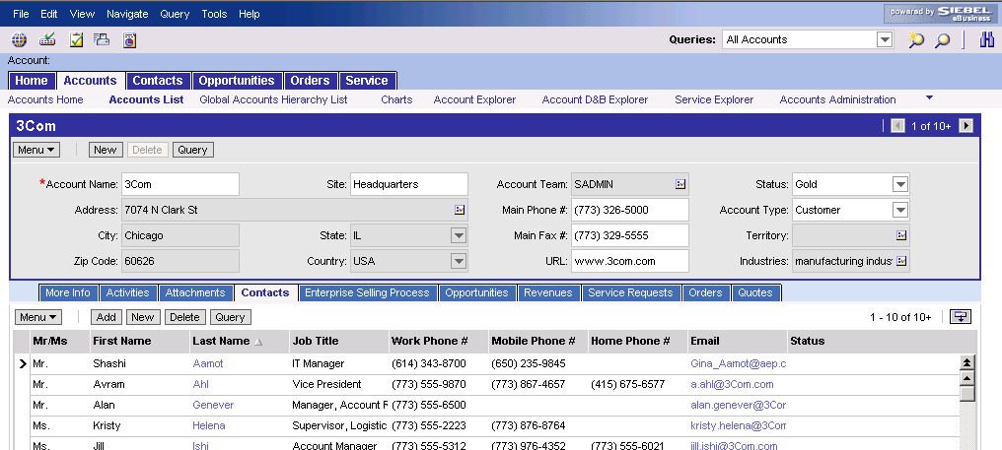
Configuring a Siebel Application
Configuring is the process of modifying a standard Siebel application using Siebel Tools to meet business needs
Object definitions are edited and created
  Developers do not modify code in siebel.exe
  Developers do not write SQL directly
Database
Tools
Application
Application
Object Manager
Repository Data
Tools output is input for Object Manager
.srf
Configured Application
Notes:
Set the scene for the module by explaining what is meant by “configuration” in Siebel terms.
The term “configuration” describes the process of changing any of the objects in the standard application, be it the UI, the business logic, or the data objects.

Slide 4

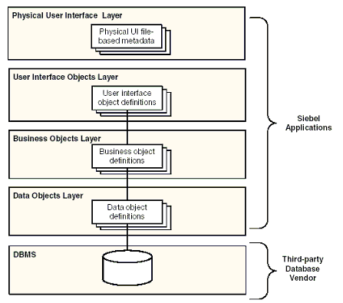
Configuring a Siebel Application
Object Layers in the Siebel Application
Notes:
The object definitions in Siebel applications fall into four architectural layers (apart from the database management system provided by a database vendor). This is illustrated above.
The Physical User Interface Layer consists of the physical files, templates, style sheets, and other file-based metadata that render the UI.
The Logical User Interface Objects Layer consists of user interface object definitions that define the visual interface that the user sees and interacts with in a Web browser. Data from business object definitions is represented to the user for viewing and modification by means of user interface object definitions.
The Business Objects layer consists of business object definitions that are built on data object definitions, and selectively combine and associate data object definitions into logical data constructs that are useful for application design.
The Data Objects layer consists of data object definitions that directly map the data structures from the underlying relational database into Siebel applications, providing access to those structures by object definitions in the Business Objects layer.

Slide 5
Tailoring the Physical User Interface
Use the existing physical UI files whenever possible
When necessary, copy existing files and modify as needed
  Modify Siebel template files to change layout
    Use an HTML or text editor
  Modify cascading style sheets to change colors, fonts, and so on
    Use a text editor
  Modify, add, or replace image files to make your organization’s images available to the application
    Create or modify these files using an appropriate graphics program
Notes:
In the physical UI, you can modify the more general appearance of the application, such as colors, font, graphic elements, and so on.
The term “physical user interface” here refers to the Web templates. Web templates contain a combination of HTML and Siebel Web Engine (SWE) tags, and are responsible for rendering the user interface of a Web application. The physical UI also includes files such as cascading style sheets and image files, which are text files that can be edited using a text editor like Notepad or a HTML tool like Microsoft FrontPage.
Examples of physical UI object are:
A Template File is a special kind of HTML file that defines the layout and formatting of elements of the user interface (such as views, applets, and controls). It provides this layout information to the Siebel Web Engine when rendering Siebel objects in the repository to HTML files.
The layout and style of HTML Web pages is dynamic, which allows simultaneous support for multiple browser types and versions (for example, Internet Explorer or Netscape). This is accomplished through the conditional branching in web templates.
The second example of physical UI objects are Siebel Tags, which are special tags you insert into Template Files. They specify how Siebel objects defined in the repository should be laid out and formatted in the final HTML page in the user’s Web browser. The process of configuring a web application separates the layout and formatting from the application definition and binding to data. You use Siebel Tags to map objects into a HTML physical layout.
And finally, Cascading Style Sheets are another example of a physical UI object. A cascading style sheet (CSS) is a simple mechanism for controlling the style of a Web document without compromising its structure, by separating visual design elements (fonts, colors, margins, and so on) from the structural logic of a Web page. A CSS includes typographical and formatting information on how the Web page should appear, such as text font. A cascading style sheet gives the developer control over the appearance of the page.
Teaching HTML editing is outside the scope of this course; we will not cover in detail the techniques of modifying templates and style sheets.

Slide 6
Tailoring the Logical User Interface
Developers tailor the standard Siebel screens, views, lists, forms, and templates to better support users’ business needs
Notes:
The job of a developer at the UI level is to modify the appearance of the application, so that it better reflects the business needs of the company and the users.
In the Logical UI, you can modify the layouts of the applets, views, screens, and applications (for example: which fields appear in what order in an applet; which applets appear in what order in a view; and so forth). Modifying templates is a change to the physical user interface, not the logical user interface, and is handled in the customer’s HTML editor of choice, not in Tools.
The Logical User Interface Objects layer consists of user interface object definitions that determine the visual interface that the user sees and interacts with in a Web browser. Data from business object definitions is represented to the user for viewing and modification by means of user interface object definitions. The Applet User Interface Object type (along with its child object types, particularly Applet Web Template) implements application units consisting of data controls, editable scrolling list tables, business graphics, and so on. Other User Interface Object types control toolbar and menu implementation, and the visual grouping of applets on screen.
The User Interface defines the visual elements with which users interact—for example:
Layout of applets and views
Navigation
User interface controls (for example, buttons and checkboxes)
The User Interface Objects Layer is insulated from the Data Objects Layer and the underlying database by the Business Objects Layer.
The object types for the Logical UI Object Layer are described briefly as follows:
Application. An application is a collection of screens. The application is opened in a Web browser on the user's desktop by attaching to a specified URL. The screens are accessed from the tab bar and the Site Map, as defined in the application. Siebel eService is an example of an application. Each combination of screens that is appropriate to a specific class of users can be provided as an application.
--Notes are continued on the next page--

Slide 7
Hidden Slide
Hidden Slide
Notes:
Page Tab. A page tab object definition associates a screen to the page tab's parent application object definition and includes it as a tab in the tab bar.
Screen. A screen is a logical collection of views. It is not a visual construct in itself; rather, it is a collection of views that the menu bar and view bar can display. The active screen is selected from the Site Map or the tab bar.
Screen Menu Item. A screen menu item object definition associates a screen to the application and includes the screen as a menu item in the Site Map.
Screen View. A screen view object definition associates a view with the screen view's parent screen object definition. This is how views are included in screens.
View. A view is a collection of applets which appear on screen at the same time. A view can be thought of as a single window's worth of related data forms (applets). The Siebel application window displays one view at any one time. The user can select the current (active) view from the second-level navigation tab or from the Site Map. A view is associated with the data and relationships in a single business object.
Applet. An applet is a form, composed of controls, that occupies a portion of the Siebel application window. An applet can be configured to allow data entry, provide a scrolling table of business component records, or display business graphics, a navigation tree, or a similar user interface unit. It provides viewing, entry, modification, and navigation capabilities for data in one business component. Popup windows for multi-value groups and record selection are also implemented as applets.
Control. One control object definition corresponds to one data control in a form applet, such as a text box, check box or command button. A control is something in the applet with which the user can interact. A control usually either exposes data from one field in the business component, or invokes programming logic (in the case of a PushButton control).
List. A list is a child object type of applet. A list object definition specifies property values that pertain to the entire scrolling list table and provides a parent object definition for a set of list columns.
List Column. A list column object definition corresponds to one column in the scrolling list table in a list applet, and to one field in the business component.
Web Template. This can be either an Applet Web Template or a View Web Template. It is used to identify external HTML (or other markup language) files that define the layout and Siebel Web Engine interactions for an applet or view.
Applet Web Template Item. Defines a control, list item, or special Web control in the Web implementation of an applet.
View Web Template Item. Defines the inclusion of an applet in the Web implementation of a view.

Slide 8
Siebel Business Entities
Siebel standard applications utilize a set of Siebel business components that implement a defined business logic
Account
Service Request
Contact
Action
Product
Notes:
In the standard application, business logic is represented as a set of defined relationships between the supplied business components.
You might remind students how we explored some of those business entities and logic in earlier modules.

Slide 9
Tailoring the Business Logic
Developers also tailor the application by modifying the definitions of the business components to implement the business logic appropriate to the users’ organization
Account
Add fields
Modify form of the relationship
Service Request
Contact
Action
Modify properties of existing fields
Product
Notes:
Configuration can take place at the Business Layer by changing elements associated with the business entities to better represent the business logic of the organization. For example, you might add another field to support data not currently represented, or change a relationship from M:M to 1:M. Siebel standard applications utilize a set of Siebel Business Components that implement a defined business logic.
The names of the business components do not change. For example, suppose a company uses the term “Customer” instead of “Account.” You would change the applets, views, and screen text to say “Customer” instead of “Account”, but the application still uses the Account business component. (Changing the name of the BC would involve a massive project of tracking down everything that referred to that BC by name and changing it, and would not be an effective use of time.)
The Business Object Layer provides a database independent view of the Siebel data model.
It contains the logical definitions of the Database’s tables and columns and stores them in Business Components and Fields.
The Business Object Layer also defines the relationships between Business Components and stores them in Business Objects.
The Business Object Layer consists of business object definitions that are built on data object definitions and selectively combine and associate data object definitions into logical data constructs that are useful for application design. The Business Object Layer in the repository is implemented by means of the object manager classes.
The major object types in the Business Object Layer are:
Business Component. One fundamental business entity in the enterprise—for example, Contact, Account, or Product
Business Object. Denotes a functional area that is a grouping of one or more related business components.
A Business Component is a logical entity that associates columns from one or more tables into a single structure. Business Components provide a layer of wrapping over tables, so that applets reference Business Components rather than the underlying tables.

Slide 10
Extending the Data Layer
Siebel standard applications contain a defined set of database tables
Developers can tailor the application by extending the set of database tables in a limited and controlled manner
S_OPTY2_X
S_OPTY1_X
S_OPTY
S_OPTY_X
ROW_ID
LAST_NAME
FST_NAME
MID_NAME
ROW_ID
LAST_NAME
FST_NAME
MID_NAME
ROW_ID
CREATED
CREATED_BY
CURCY_CD
ROW_ID
Notes:
This slide is done differently to capture the idea that developers aren’t expected to do much configuration at the Data layer. Hence, we use terms like “extending” the Data layer in a limited and controlled manner.
The standard application comes with a pre-defined data model, that is, a standard set of tables. You can configure the application at the Data Objects layer by adding columns to tables, or by adding new tables to extend the functionality of the data model.
Note that Siebel Systems supplies predefined extension tables. Customers can also create their own extension tables. Also note that there are possible consequences when you extend the data model, for example, it can affect EIM data imports.
Extension tables and columns and their usage in Siebel applications is discussed in upcoming modules.

Slide 11

Set Up a Developer
To set up a developer as a configurator:
  Install appropriate server and client software
  Install and verify the Tools client
  Create the developer
  Create a database user login
  Generate the local database
  template
  Extract the local database
  Initialize the local database
  Populate the local database
Tools client
Enterprise Server
Siebel Server
Component
Component
ODBC
Database
Server
Notes:
This slide outlines the steps to create a user as a self-sufficient developer.
Do not teach all the points in detail here because they are explored on the slides that follow. In the classroom environment, Siebel Tools should already be installed.

Slide 12
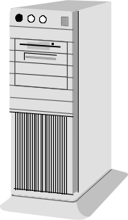

Install Tools Client
Use the seatools installation program to install Tools and set up ODBC data sources
Example:
Tools Client
Destination Directory:
C:\SUsea\tools
Siebel Remote Server:
SERVER01
D1
File System:
HQ\SVR2\c:\siebfile
Database Machine Name:
SERVER02
SSD Local Db c:/SUsea/tools
SSD c:/SUsea/tools
Database/Tablespace:
siebeldb
ODBC User Data sources
Notes:
This slide reviews material covered in the installation module.
Siebel Tools is actually a specialized dedicated client.
The File System parameter can be set a UNC name, such as HQ\SVR2\siebfile, or a local path, such as c:\siebfile.
The ODBC data sources are commonly named SSD default instance and SSD Local Db Default Instance.

Slide 13
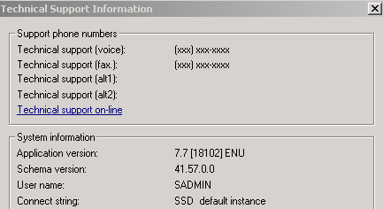
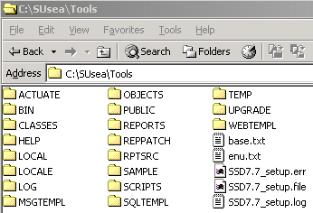
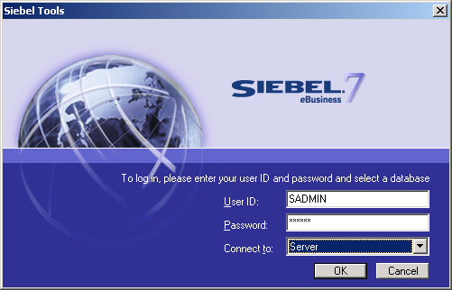
Verify Tools Client
Inspect directory and SSD7.7setup.log file (in the Tools directory)
Verify application launch and database connection
  Example:
ODBC data source for the server database
Notes:
This slide shows mechanisms used to verify that the Tools client is connecting correctly to the server datasource.
Tools always communicates with the server database using ODBC. The “Connect String” is what is referenced inside the Tools.cfg file as the ODBC source.

Slide 14


Create the Developer
Add the developer as an employee and associate a position and responsibility
Register the developer as a mobile client
Notes:
Students have already created employees when they set up the company structure in the Security section. The only new thing here is the mobile client. PPENGUIN is the login used for the developer user in the course.
The developer user is created as a mobile client because they need to use a local database.

Slide 15
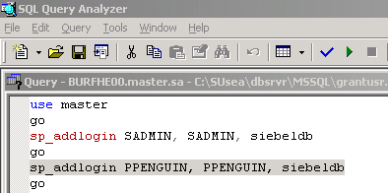
Create a Database User Login
Create a corresponding database login using RDBMS tools and the grantusr.sql script as a template
Example:
Notes:
There must be a corresponding database account for the user. This is an activity typically performed by a database administrator.
The grantuser.sql script, which resides in
C:\SUsea\dbsrvr\ <database server type>,
contains the syntax for creating a database user in the respective RDBMS.
The screenshot includes a sample from the grantusr.sql script. The format of the commands are specific to the server database. This sample shows MS SQL Server syntax (the RDBMS used in the labs).

Slide 16

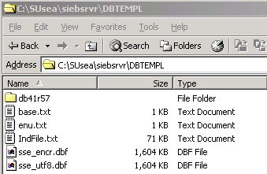
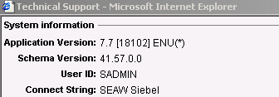
Generate the Local Database Template
Run the Generate New Database server task to generate a local database template
  Snapshot of the current version of the database schema
Notes:
The Generate New Database server task creates a series of files which capture the current database’s structure (schema), at that point in time. Therefore, the developer user has a representation of the same tables and columns contained in the server database on their local database. Note the output of this server task is placed under a directory called DBTEMPL on the server machine.
Students have seen how to run server tasks in prior modules. This is the first real application. Notice that the template is specific to a given version of the database schema.
If columns are added, a new template needs to be created. The template here is for SQL Anywhere, but one can also be generated for MS SQL Server. This would be defined in the Client Db Type parameter in the Generate New Database task. The task is discussed in more detail in the modules on Siebel Remote.

Slide 17

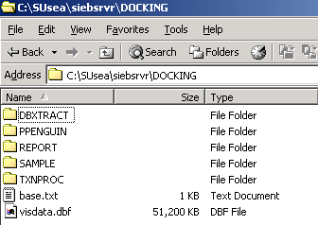
Extract the Local Database
Run the Database Extract server task to extract user data
Notes:
Database Extract retrieves from the server database the user visible data for a specific mobile client, and packages the data into compressed files. When the database is initialized, this data is then used to populate the local database. As the data is “user visible,” users need to have positions defined for them to work out which data they have access to.
The Database Extract task uses the files from the Generate New Database task, which should be run immediately before it.
Only user data, and not repository data, is inspected.
As an alternate solution, students can run Database Extract with the Parameter “Extract All Repository Tables” set to TRUE. This includes repository data in the database extract, which eliminates the need to perform a full Get later in the process.
The students will perform a full Get in the labs for the learning experience and because it minimizes risk in the classroom.

Slide 18
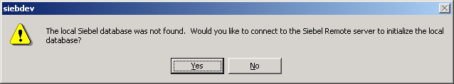
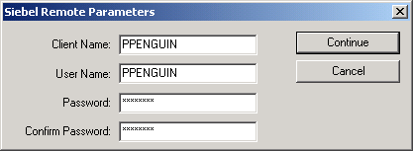
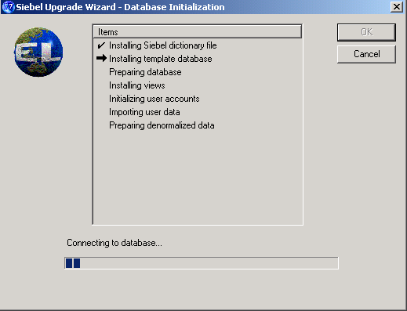
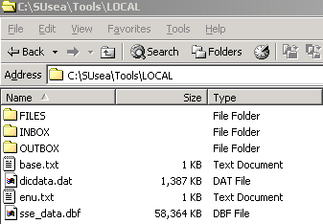
Initialize the Local Database
Synchronize from Tools client to create local database (sse_data.dbf) and populate it with user data
Notes:
Database initialization creates a database by the name of sse_data.dbf, and then populates it with the data visible to the user. The local client connects to the Siebel Server to pull down the database schema and data files to create a new local database. Again, this is covered in detail later in the Siebel Remote modules.

Slide 19
Populate the Local Database
Use Siebel Tools to copy repository data from the server database to the local database
Database
Repository Data
Tools
Client
Server Database
Local Database
Notes:
Because we want to perform configuration tasks using this database, we need the repository data. This data does not come from Database Extract.
Database Extract is done for all mobile users, but repository information is specific to developers. Therefore they use the Siebel Tools software to connect to the server using ODBC and copy the repository data into the local database.
Students have not yet been exposed to GET nor Projects in detail. GET, a process initiated from inside Siebel Tools, copies repository data residing on the server database to the local developer’s database. This is discussed in an upcoming module. It is the initial process of copying over all projects (and the object definitions they contain) from the server to the local database.

Slide 20

Additional Developers
For each additional developer
  Create the developer
  Create a database user login
  Extract the local database
  Initialize the local database
  Populate the local database
Server Machine
Developer Workstation
Developer Workstation
Developer Workstation
Master
Local
Local
Local
Notes:
This slide summarizes the work that must be done for each additional developer.
Each developer should have his or her own machine, and needs to undergo the same process steps described. The result is each developer has their own local databases and an exact copy of all the definitions that reside in the server repository.

Slide 21
Summary
This module showed you how to:
  Explain the process of configuring a Siebel application
  List the critical elements of the Siebel configuration strategy
  Set up the Siebel developer environment
Notes:
Review Question: When would developers working on a Siebel configuration modify the code in siebel.exe?
Answer: They wouldn’t.
Review Question: Why should you set up a separate development environment for configuration?
Answer: To isolate the development effort from the enterprise’s production database. Also acceptable: To allow developers to work independently on different aspects of the development effort; to test customizations and extensions thoroughly prior to deployment.

Slide 22
Lab
In the lab you will:
  Set up an employee as a developer
  Extract a local database for the developer
  Populate the developer’s local database with repository data
Notes:
See lab instructions for more detail.
Please note: These labs do not include solutions.

